Slide 1
Comparing Audio Decompositions for Sound Synthesis with Deep Neural Networks
Harry Twigg

Slide 2
Machine Learning is rapidly transforming audio processing, yielding wide ranging applications in business and for artists, amongst others.
One particularly interesting area is the use of deep based learning methods for music sound synthesis.

Slide 3
Aim
It is foreseeable that some machine learning sound synthesis methods have potential to be built on further, whilst others may be deemed obsolete.
This project aims to compare these methods, evaluating the advantages and disadvantages of how audio signals are encoded and presented to them.
In an optimistic scenario, new methods of audio signal encoding and deep learning methods for sound synthesis shall be researched and proposed.

Slide 4
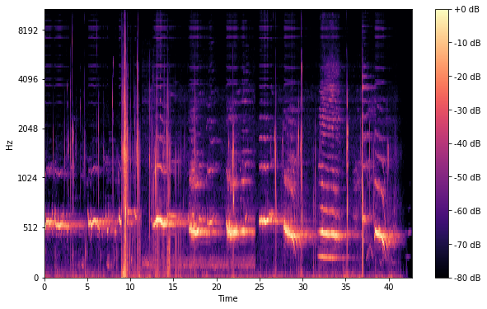
Objectives
Evaluate existing methods of audio signal encoding with a focus on the following machine learning areas and the way data is presented to the network (but not limited to):
Frequency based Fourier coefficient methods eg. Tacotron, GANSynth
Autoregressive whole single sample methods eg. Wavenet, SampleRNN
DDSP a novel modular approach to sound synthesis
A Mel Spectrogram, a method of presenting frequency and amplitude information to a neural network as an image

Slide 5
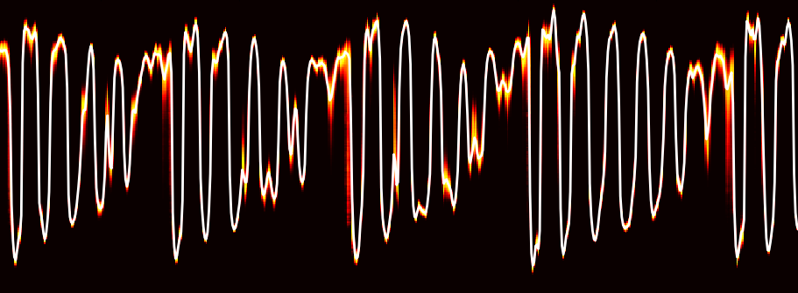
Investigate potentially innovative new methods of sound synthesis and encoding, building on existing researched work, this could include:
The use of a new encoding method or formatting of the input signal
Building on top of existing sound Synthesis Models, potentially making use of alternative ways of encoding and presenting data to the deep network.
Finding a way of incorporating lost data (e.g. Phase) into the encoded data that is presented to the model.

